Slide 1
Final Year Project Viva Voce
Performance analysis and optimisation of wireless-powered CRN’S using ambient backscatter communication
Seshasayi Rangaraj
108116079
Rohan Babu
108116072
Project Guide: Dr. B.Rebekka
Assistant Professor, Department of ECE
NIT Trichy

Slide 2
Table of contents
Item | Slide Number
Problem Statement and Objectives | 3
Introduction | 4
Literature survey | 6
Proposed Model | 7
Results | 17
Discussions | 41
Conclusions | 44
Future scope | 45
References | 46

Slide 3

Problem statement || Objectives
.
To design an energy efficient ambient backscatter wireless CRN network for an energy constrained system that consists of multiple secondary transmitters, spatially distributed, in TDMA and both primary and secondary sensor networks consisting of heterogeneous channels, and compare the performance based on Outage, Throughput and SNR.
Mathematical form
To empirically derive the mathematical constructs for Outage Probability for the system Model we have constructed for both Rayleigh and Nakagami Channels.
Comparative analysis To plot and systematically study the variations of .Outage Probability with reflection coefficient, threshold Signal to Noise Ratio, distance parameters, shape parameters,spread parameters etc,
Ablation study To compare the results obtained in both the channel models used with the model used in the base paper to prove superiority of our model, and to finding out the threshold on the number of users

Slide 4
Introduction
Ambient Backscatter Network - Ambient backscatter uses existing radio frequency signals, such as radio, television, mobile telephony etc., to transmit data without a battery or power grid connection.
Base station
‘0’ bit – Absorb Power Signal ‘1’ bit – Reflect Power signal
Backscatter
Digital Electronics Lab
Wireless Communication Lab
Figure 1

Slide 5
Antenna
Radio Frequency Energy Harvesting & Power Management
Receiver
Digital Logic Implementation
User Interface (Mobile, Multimedia etc. )
Transmitter
Block Diagram of a backscatter network
Figure 2

Slide 6
Literature Survey on the Outage Probability analysis for backscatter networks
Technology | Paper | Author | Year of publication | Novelty
Designing and development of Backscatter nodes. | Performance characterisation of Relaying using Backscatter Devices | Xiaolun Jia et al. | 2018 | Usage of Amplify and forward and decode and forward backscatter relaying used.
Multi tag selection combination scheme | Performance Analysis for Tag Selection in Backscatter Communication Systems over Nakagami-m Fading Channels | Yu Zhang et al. | 2018 | The closed-form analytical outage probabilities for the two correlation circumstances are utilised to perform the study.
A novel ratio detector concept | Signal Ratio detection and Approximate Performance analysis for Ambient Backscatter devices | Shuo Ma et al. | 2018 | To derive a reasonable approximate expression for the optimal detection threshold using closed form expressions
Underlay Cognitive Network | Performance Analysis of Wireless CRSN’s | Daniyal Munir et al. | 2019 | The outage probability of three symbiotic radio paradigms, namely, commensal, parasitic, and competitive schemes, are studied in a cooperative ambient backscatter system,
Notes:
Mention the last one as our Base model.

Slide 7
Proposed Model
PT - Primary Transmitter
PR - Primary Receiver
STi - i^{th} Secondary Transmitter
SR - Secondary Receiver
PT
PR
TDMA
………………....
………………....
ST1
STi
STn
SR
Figure 3

Slide 8
Attributes of proposed model
The proposed novel model involves
-> An ambient backscatter network that has a primary system with one Primary transmitter, one primary receiver, and a secondary backscatter network with multiple secondary transmitters and single secondary receiver.
-> Our model offers a solution to a particular use case of having multiple secondary users in a network, but not enough power (dedicated RF source) to transmit their signals to their respective secondary receivers. -> In addition, we focus on introducing multiplexing access schemes - TDMA at the access points of the secondary sensor nodes. This is one major contribution that we propose to eliminate the inactivity in the network, thereby reducing the idle time and improving the overall network efficiency.

Slide 9
-> Our model optimizes the power received at the secondary sensor network ie., the secondary transmitting nodes use only the basic amount of power needed to transfer the message bits to the corresponding secondary receivers, and the excess power is stored and harvested for other applications like powering LED's, converting into other forms of energy, stored to meet other power demands,
-> Design of an efficient backscatter network with more efficiency, less waiting time, and inbuilt harvesting mechanisms with the help of cognitive and multiplexing schemes.

Slide 10
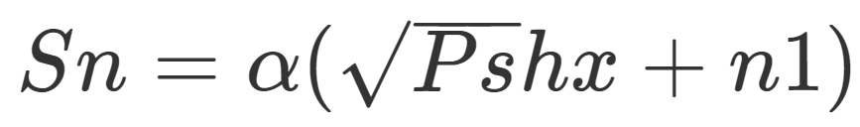
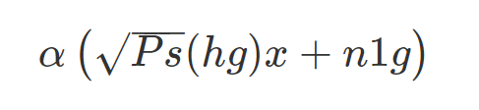
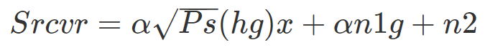
Mathematical derivations for our proposed model
We know,
Secondary TVans
(1)
Secondary Receiver
We attempt to minimize this parameter
Key: h, g are channel PDF’s; n1,n2 = AWGN 𝛂: Reflection Coefficient; Ps = Power Src

Slide 11
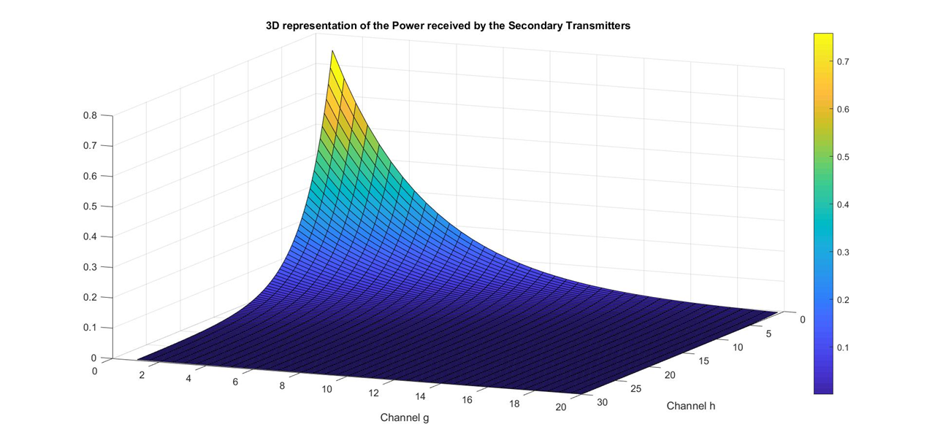
Simulation obtained by plotting the variation of the output Signal (in equation (1) received at the secondary transmitter with respect to the two channels – h and g. This has been done on MATLAB.
Figure 4

Slide 12
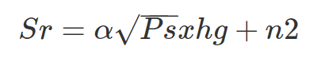
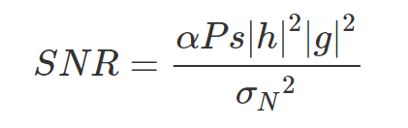
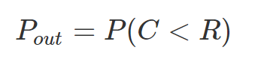
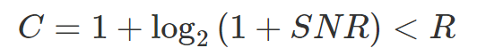
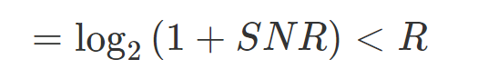
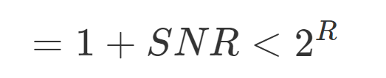
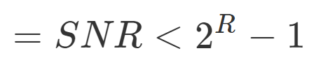
(2)
(By definition)
where R is assumed as the channel capacity threshold
{ }

Slide 13
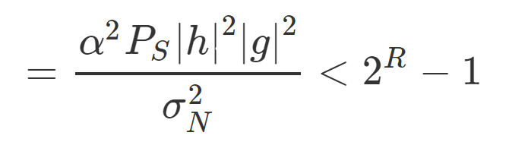
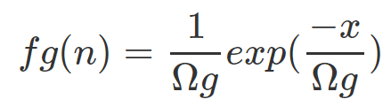
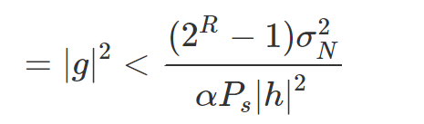
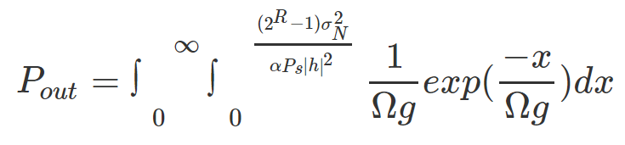
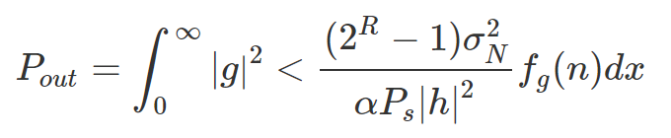
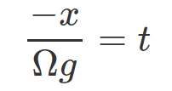
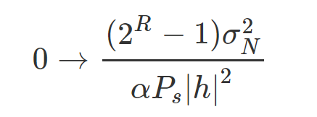
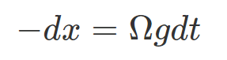
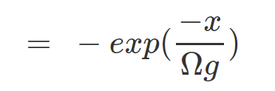
(3)
(Rayleigh distribution)
Substituting (3)
= limits of g are from
Key: R = Threshold Channel Capacity; 𝛀g = Distance parameter of channel g; 𝛀h= Distance parameter of channel h

Slide 14
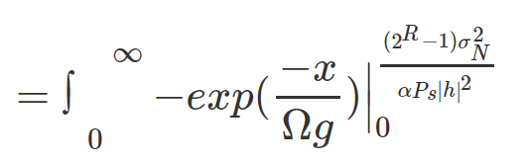
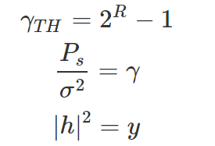
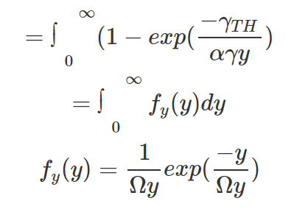
(4)
Substitutions in equation 4:
(Rayleigh Distribution)

Slide 15
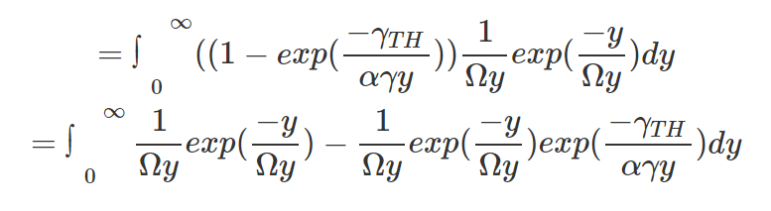
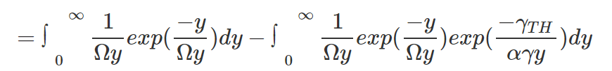
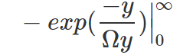
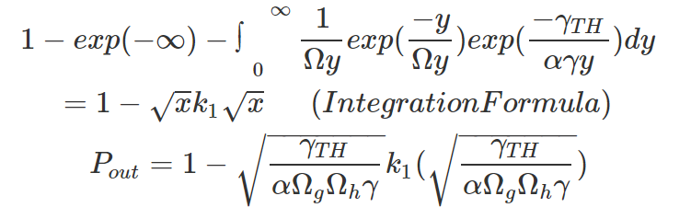
(Where k1 ⋲ Bessel F’n)
Referring equation 3.81 in the book mentioned in References
(5)

Slide 16
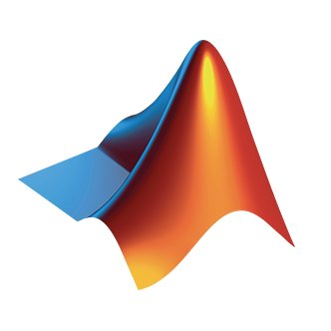
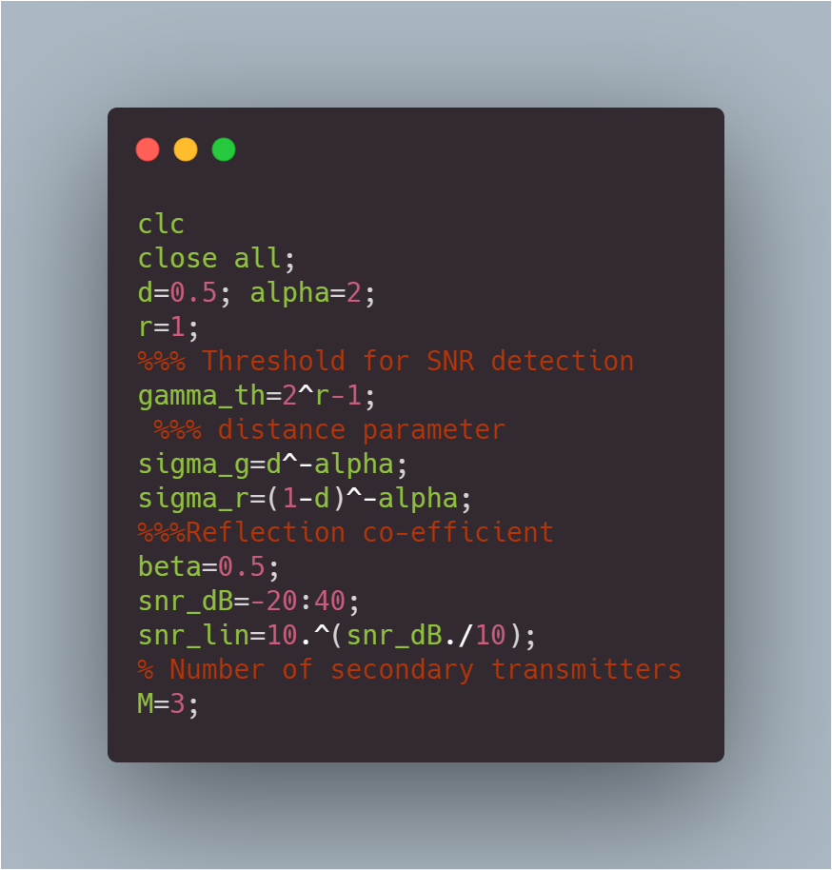
Simulation parameters - Rayleigh
Matlab Code
Values of parameters taken to obtain simulation
Distance d = 0.5
𝛂 = 2;
r = 1;
Ɣ = 1;
Distance parameters for rayleigh model:
𝝮_g = 0.5;
𝝮_r = 0.5;
𝝱 = 0.5;
M = 3; Number of secondary transmitters

Slide 17
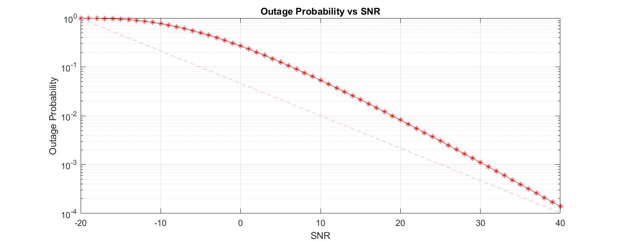
Variation of Outage Probability with SNR
Simulations
Figure 5
(Pout )
(dB)

Slide 18
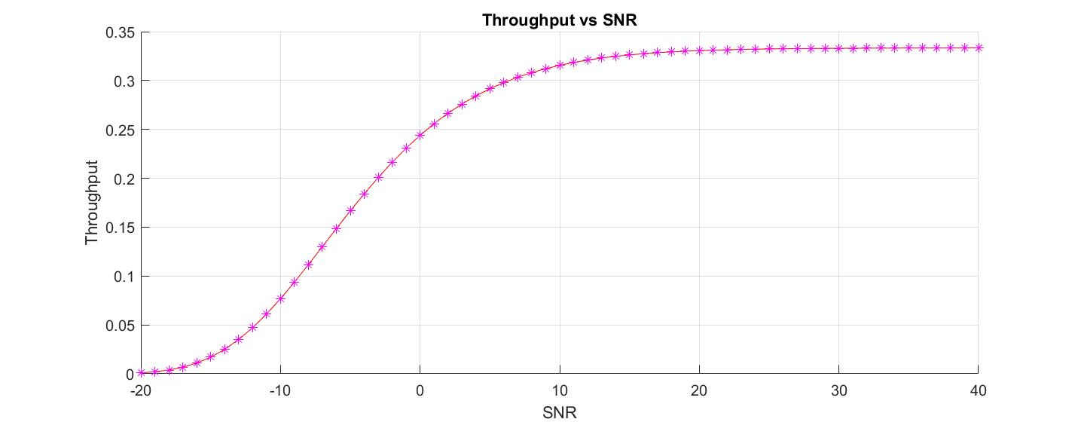
Variation of Throughput with SNR
Figure 6
(bps )
(dB)

Slide 19
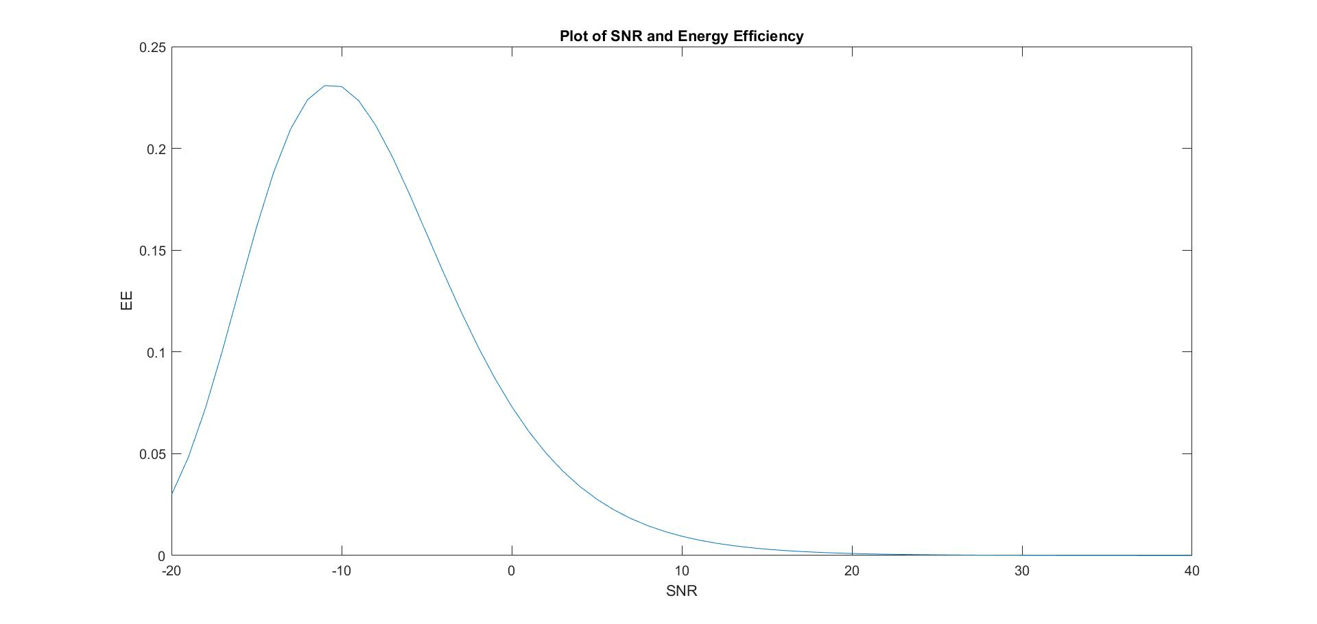
Variation of Energy Efficiency with SNR
Figure 7
(J)
(dB)

Slide 20
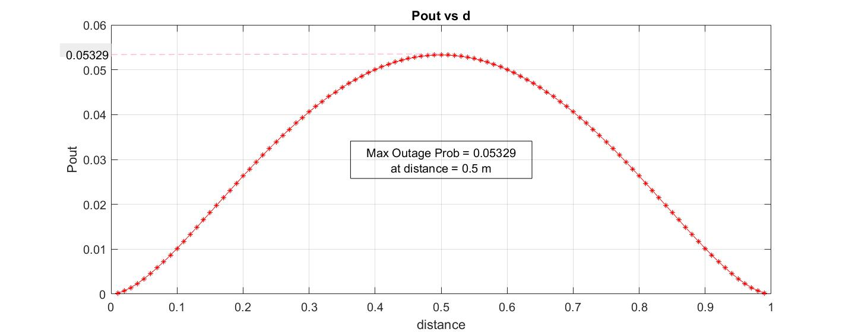
Variation of Outage Probability with distance
Figure 8
(m )

Slide 21
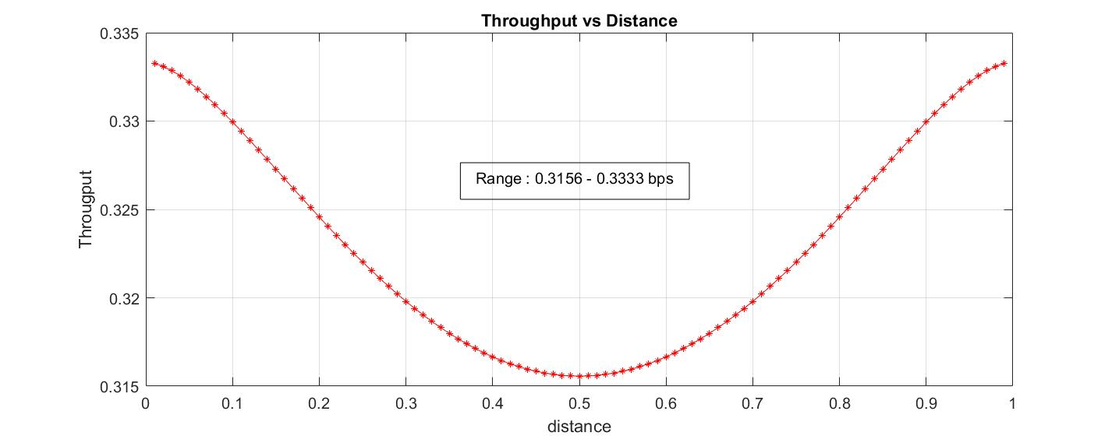
Variation of Throughput with distance
Figure 9
(bps)
(m)

Slide 22
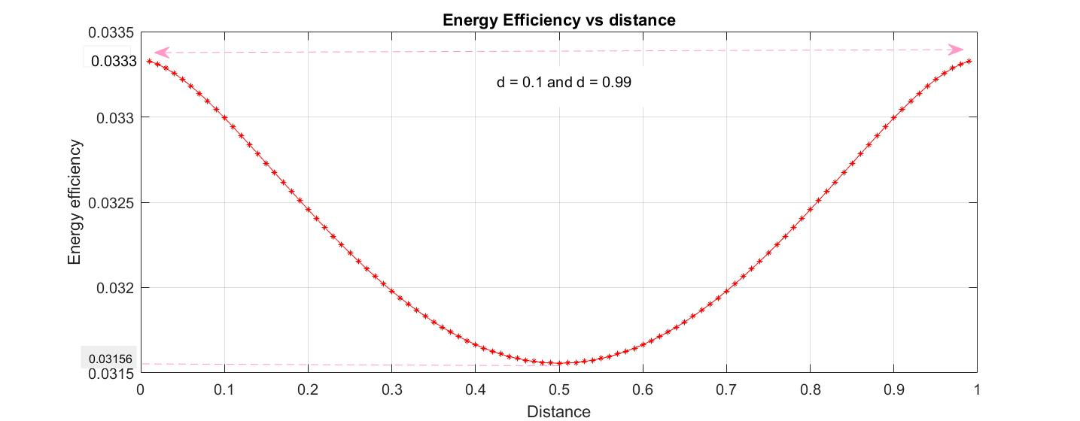
Variation of Energy Efficiency with SNR
Figure 10
(J)
(m)

Slide 23
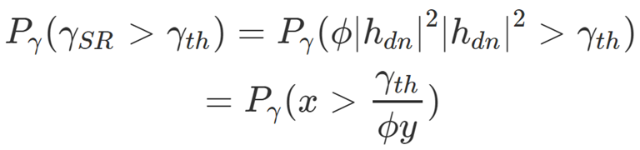
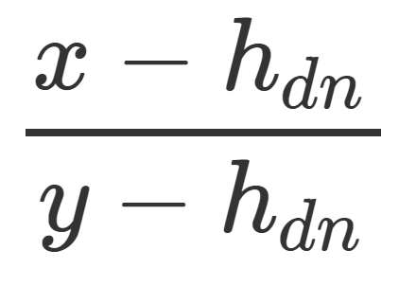
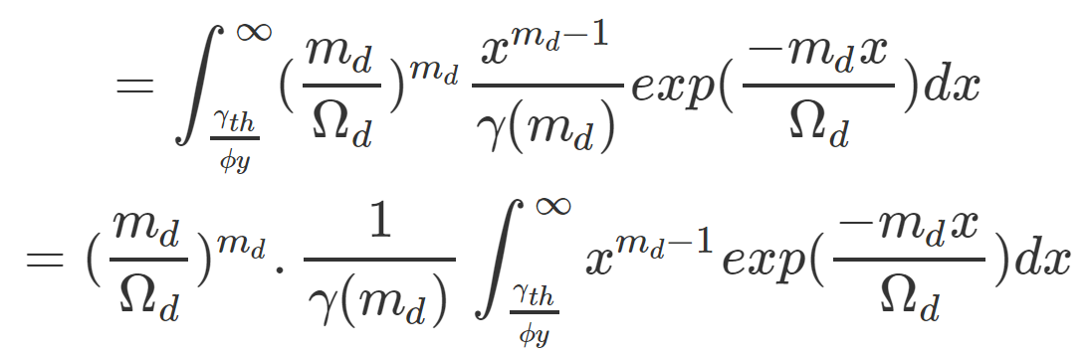
Mathematical derivations for Nakagami model
(1)
First integrating wrt ‘x’ keeping ‘y’ constant
Using formula from Tables of Integrals equation 3.381

Slide 24
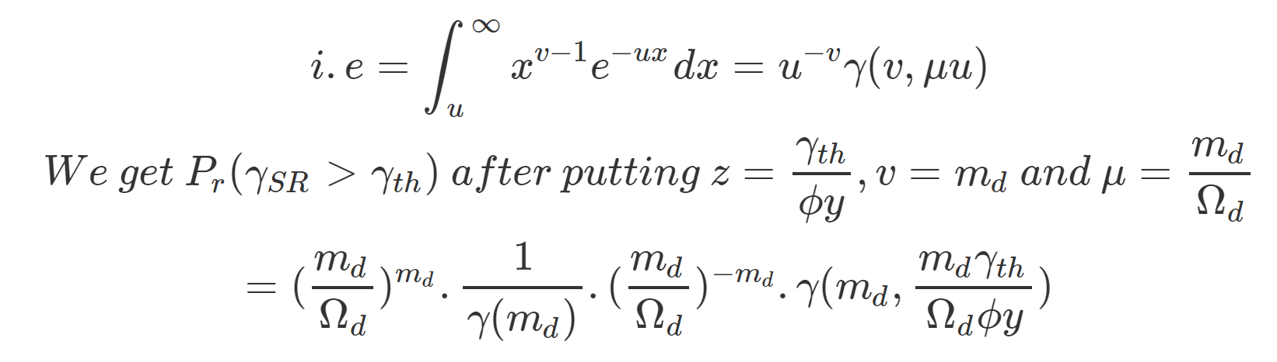
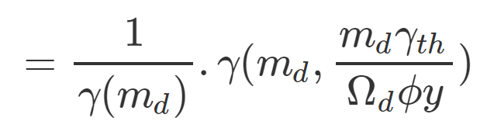
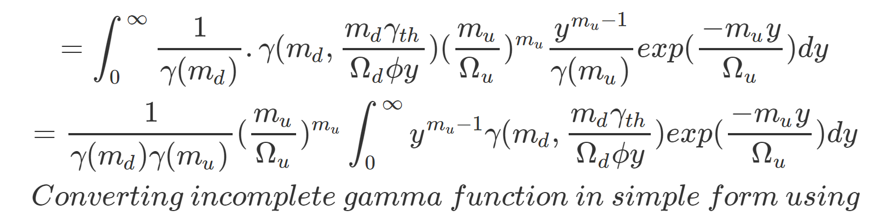
(2)
Now integrating wrt ‘y’

Slide 25
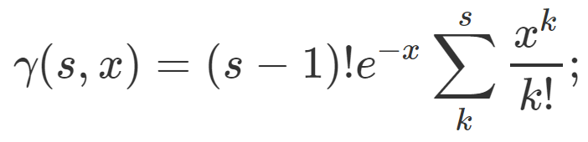
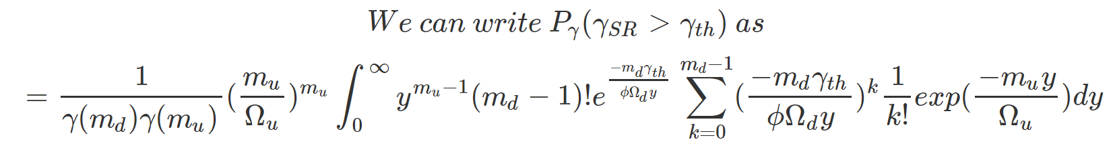
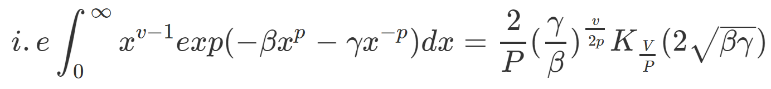
s is +ve integer
{Substituting the approximation formula}
(3)
Using formula from Tables of Integrals equation 3.478

Slide 26
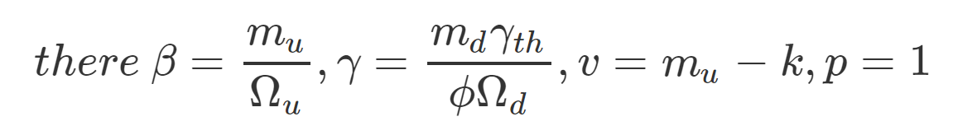
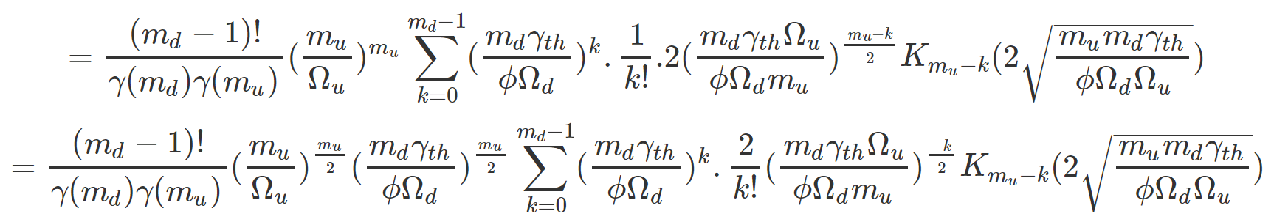
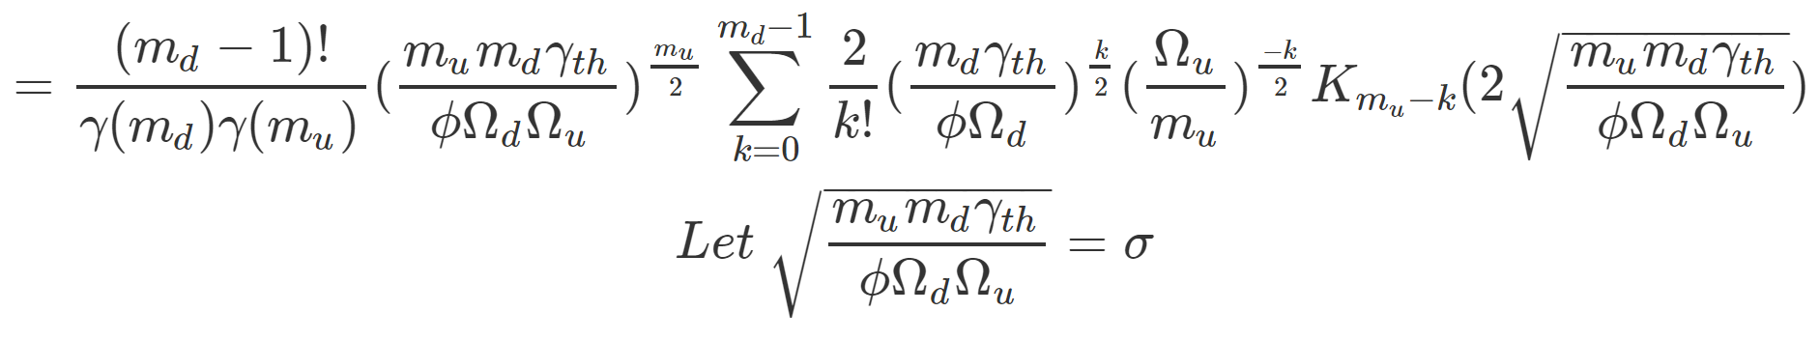
(4)

Slide 27
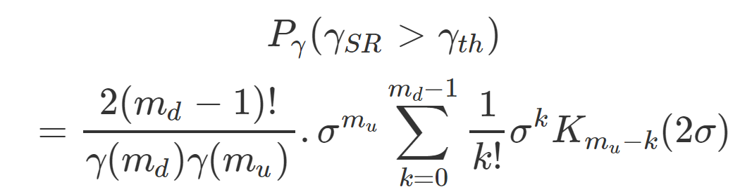
Final Outage Expression
Pout = 1-
(5)
Equation 5 gives us the final outage expression for a Nakagami model with the given shape and spread parameters

Slide 28
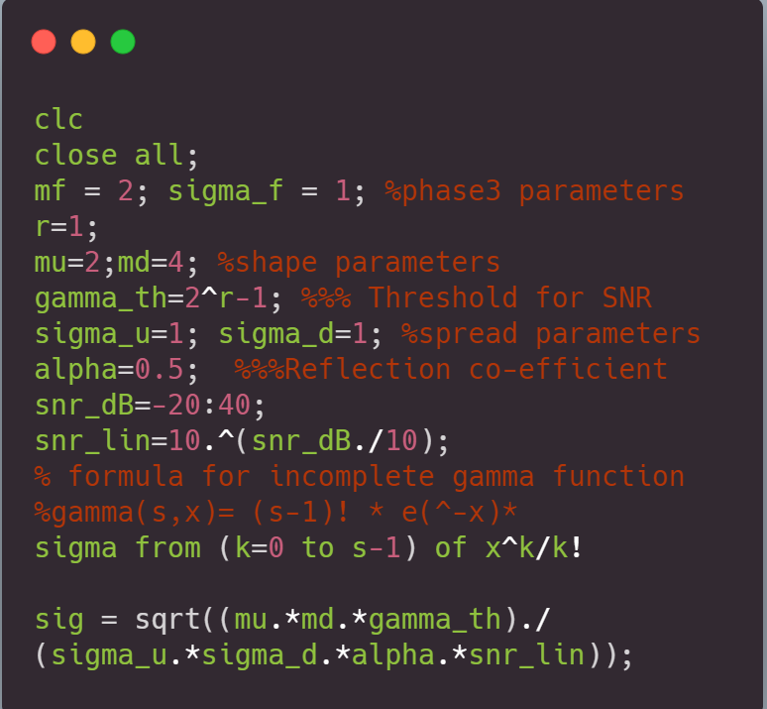
Simulation parameters - Nakagami
Matlab Code
Values of parameters taken to obtain simulation
𝛂 = 0.5;
r = 1;
Ɣ = 1;
Spread parameters for Nakagami model:
𝝮_u = 1;
𝝮_d = 1;
Shape Parameters for Nakagami model:
mu = 2;
md = 4;
M = 3; Number of secondary transmitters

Slide 29
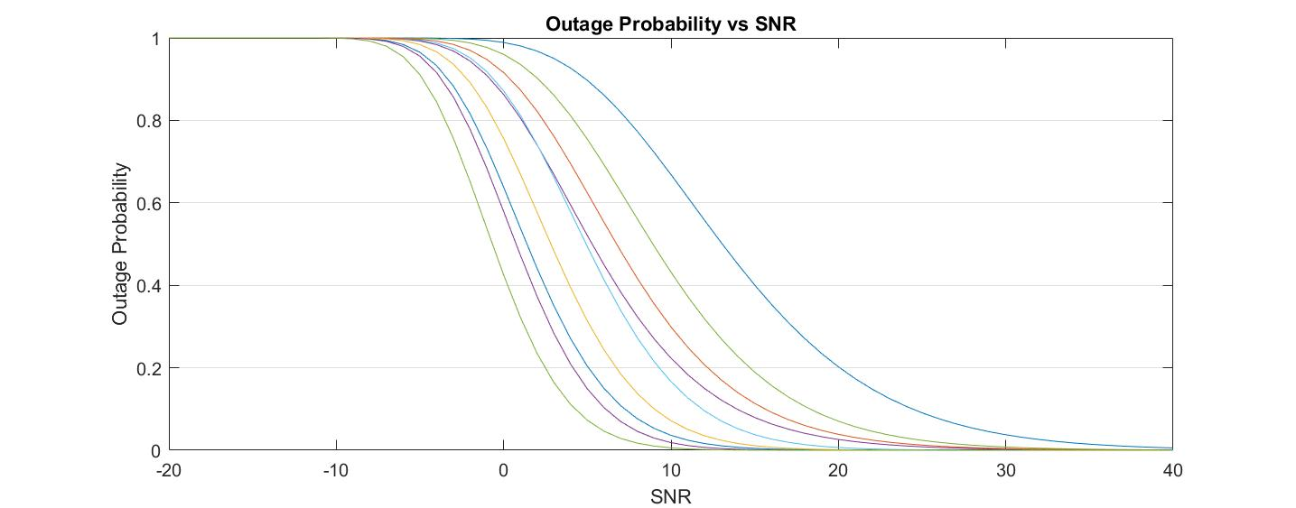
Variation of Outage Probability with SNR
Simulations (Nakagami)
(Pout )
(dB)
Figure 11

Slide 30

Variation of Outage Probability with SNR
Figure 12
(bps)
(dB)

Slide 31

Variation of Outage Probability with SNR
Figure 13
(J)
(dB)

Slide 32

Variation of Outage Probability with Reflection coeff.
Variations with Ref Coeff(Nakagami)
Figure 14
(Pout)
(α)

Slide 33

Variation Throughput with Reflection coeff.
Figure 15
(bps)
(dB)

Slide 34

Variation of Energy Efficiency with Reflection coeff.
Figure 16
(J)
(α)

Slide 35

Variation of Outage Prob. with M varying SNR
Variations with number of secondary transmitters
Figure 17

Slide 36

Variation of Outage Prob. with M varying Beta
Figure 18

Slide 37

Variation of Outage Prob. with M varying distance
Figure 19

Slide 38
Figure 20

Slide 39
Results
Table 1: Performance Analysis of our model in comparison with the base model on three parameters - Outage Probability, Throughput and Energy
 | Base Model | Our model
Metrics obtained (at Secondary receiver) |  | Rayleigh | Nakagami
Outage Probability at 0dB (vs SNR) | NA | 0.323 | 0.1627
Throughput (bps) (Maximum) | 0.35 | 0.333 | 0.333
Energy (Joules) (Maximum) | 0.6 | 0.23 | 0.7124

Slide 40
Table 2: Variation in Outage Probabilities with the simultaneous variations in both α and Distance.
 | Reflection Coefficient(α) |  |  |  | Number of Secondary Transmitters
 | 0.25 | 0.5 | 0.75 | 1
Outage Probability | 0.3 | 0.33 | 0.38 | 0.534 | 2
 | 0.15 | 0.18 | 0.19 | 0.22 | 4
 | 0.14 | 0.15 | 0.156 | 0.16 | 6
 | 0.135 | 0.143 | 0.15 | 0.153 | 8
Table 3: Variation in Outage Probabilities with the simultaneous variations in both M and Distance.
 | Distance (m) |  |  |  | Number of Secondary Transmitters
 | 0.1 | 0.2 | 0.3 | 0.4
Outage Probability | 0.15 | 0.28 | 0.35 | 0.38 | 2
 | 0.08 | 0.15 | 0.18 | 0.19 | 4
 | 0.05 | 0.1 | 0.14 | 0.15 | 6
 | 0.04 | 0.06 | 0.07 | 0.08 | 8

Slide 41
Discussions
Comparisons with original model
The backscatter communication network used in the base paper uses all the ‘N’ secondary transmitters to transmit at the same time in backscatter mode and averages the resultant outage probability, channel capacity among other parameters.
In our model, we utilise the concept of multiplexing, thereby introducing novelty. Our motive is to attempt to use TDMA to allow one one secondary transmitter to transmit to the secondary destination by dividing it into time slots. We perform our parameter analysis by using the equation derived in our definition.

Slide 42
Discussions
Interpreting the simulations
2) We observe the variation of outage Probability with distance. In that plot that we observed, it can be interpreted that the Outage Probability keeps increasing till a certain optimal distance is reached after which the Probability starts to decrease.
3) The throughput also follows the inverse relation and keeps decreasing till it reaches a certain minima where inflection takes place. The range of throughput is indicated as 0.3156 - 0.3333 bps
4) The energy efficiency vs distance plot shows us that maximum energy is obtained at two particular distances from the PT = 0.1 and 0.99 m.

Slide 43
Discussions
Interpreting the simulations
5) We also observe the variation of outage Probability with the number of Secondary Transmitters as this is vital to deciding system capacity. The plots for Outage Prob variation with SNR, distance and Reflection Coeff. keeping the other respective parameters constant help us understand the system complexities better.
6) We also derive the plots for all these parameters for the Nakagami - m fading channel. The shape parameters that categorise this channel have been obtained till a maximum value of 5 for practical purposes.
7) We observe that the Energy Output (averaged over varying values of shape params) - 0.7124J is higher than that of Rayleigh, thus yielding a more energy efficient model. – 0.23 J

Slide 44
Conclusions
A comprehensive study of outage analysis has been performed to study the variations of Outage Probability, Throughput and Energy Efficiency with SNR, Reflection Coefficient and distance respectively.
The study involved obtaining the mathematical derivations for Outage for the two channel models from scratch - and using it to analyse our system model.
Our results indicate that our model is superior in terms of Energy Output but lacks on the Throughput.
We also observer that increasing the number of users in the secondary Transmitters leads to a decrease in the Outage, thereby leading to a limit on the number of secondary users.

Slide 45
Future scope
TDMA has been explored to inject a different form of transmission scheme. This also opens the scope for the possibilities of exploring other multiplexing schemes like NOMA, FDMA etc. to yield more throughput.
In addition, we obtain results for Rayleigh and Nakagami channel models. This takes into account only LOS communication and NLOS communications. However, from our results, we observe that the Outage is more for a Rayleigh model and Energy more for the nakagami model. So, we need to establish a channel model that is a combination of these two - could involve a model similar to Weibull distribution (combination of exponential and higher orders of x)

Slide 46

References
.
Munir, Daniyal, et al. "Performance analysis of wireless-powered cognitive radio networks with ambient backscatter." EURASIP Journal on Wireless Communications and Networking 2019.1 (2019): 1-13.
Jang, K.H., Kim, S.M. and Kim, J., 2019, July. Performance Analysis of Multi-Tag Multi-Reader Ambient Backscatter Communication Systems. In 2019 Eleventh International Conference on Ubiquitous and Future Networks (ICUFN) (pp. 422-425). IEEE.
Zhang, Y., Gao, F., Fan, L., Jin, S. and Zhu, H., 2018, May. Performance analysis for tag selection in backscatter communication systems over Nakagami-m fading channels. In 2018 IEEE International Conference on Communications (ICC) (pp. 1-5). IEEE.
Beaulieu, N.C. and Cheng, C., 2005. Efficient Nakagami-m fading channel simulation. IEEE Transactions on Vehicular Technology, 54(2), pp.413-424..
Zhao, W., Wang, G., Fan, R., Fan, L.S. and Atapattu, S., 2018. Ambient backscatter communication systems: Capacity and outage performance analysis. IEEE Access, 6, pp.22695-22704.
Table of Integrals, Series and Products by I.S.Gradshteyn and I.M.Rhyzik, 1985

